Slide 1
Plagiarism
Detector
Using C language

Slide 2
Members
Name
Roll Numbers
Subir Gupta
19EE10059
Hassanul Haque
19EE10068
Devendra Sanklecha
19EE10020

Slide 3
Contents
Introduction
Understanding the need
Motivation
Problem Statement
Pseudo-code of PART-1
Time-Complexity & Space-Complexity Analysis
Pseudo-code of PART-2
Time-Complexity & Space-Complexity Analysis
Conclusions
Future Work

Slide 4
Introduction
The act of plagiarizing is when you use someone's else words and ideas without giving due credits to the original writer and regard the work as your own. Plagiarism is defined by S. Hannabuss as “is the act of imitating or copying or using somebody else’s creation or idea without permission and presenting it as one’s own.”
Plagiarism is similar to the act of stealing. If the act of stealing someone's car, watches, cell phone and others is punishable by law, surely the act of stealing someone ideas, thoughts, writings or words is also considered wrongful.
However, this does not mean that students should not view other's works or sources for references. Taking in opinions and ideas from experts in order to increase knowledge is a good thing, but most importantly is to make sure that the origin of the sources and the relevant cited references are duly credited. Failure to credit the original writer is considered as plagiarism.

Slide 5
Understanding the need
Plagiarism in coding is not entirely a new phenomenon. The issue has been discussed and studied previously by researchers to identify the severity of the problem and what factors contribute to the act of plagiarism. In programming assignment , plagiarism does not necessary only involve copying the source code but if someone include comments, program input data and interface designs that can also be considered as plagiarizing
Plagiarism in coding is hard to be detected because of the similar coding used for the same application. Plagiarism in coding is easy to do, but difficult to detect (as cited in N. Wagner, 2000). Students copy all or part of a program from some source or from 2 different sources and submit the copy as their own work. This includes students who collaborate and submit similar work. Such plagiarism is felt to be common, though the true extent is hard to assess. When a teacher in a programming course gives same assignment problems to all students then all students have to work on same problems. So it is the possibility that some students write source code of problems by their own and remaining students just take the code from them and amend it like changing of variable names, changing the order of statements, functions and variables of class and submit it. These types of modifications in source code are very difficult to catch

Slide 6
Motivation
The motivation to carry out the research is based on the need for a program that is able to simplify the task of lecturer in checking accurately through student‟s coding of C files, line by line in ensuring no duplication is being made from other sources. This is to avoid too much time spent on examining a single assignment and to ensure that equal time is given on the checking of each assignment. The research includes suggestion on different methods in detecting plagiarism in C code files(although can be extended to other programming languages) and recommendation on best approaches for future work and study references.

Slide 7
Problem Statement
Faculty members of Algorithms Lab are searching for a good Plagiarism Detector that they can use to find out the students involved in malpractices.They have N programming files in C language submitted by N different students.
Help them to search those students by providing them percentage plagiarism between all possible set of two files in a rankwised manner.
Constraints
Maximum number of characters in file_name including extension is 100
Maximum number of characters in a particular line of a code is 1000

Slide 8
Input & Output specifications
For executing the program, user has to enter command line arguments.
Input: Plagiarism_Detector N file_1 file_2 file_3 ……………………………. file_N
where N = number of files to be checked,
and file_1, file_2, .... , file_N are the names of the respective files(with extensions).
Output:
File_name File_name Percentage Plagiarism
file_1.c file_5.c 88.96 %
file_4.c file_9.c 80.56 %
…... ……. …….
….. ……. …….
Average plagiarism = 82%

Slide 9
Pseudocode Of PART-1
declare a structure to store result of each set of files to be compared i.e which and which file is compared and what is the
percentage plagiarism
main(argc, argv) {
total_files = atoi(argv[1]);
number_comparisons = (total_files * (total_files - 1)) / 2;
declare a pointer to a pointer to a char named file_name
check if there is inappropriate number of command-line arguments or if number of file names entered is not equal to
number of files entered
create an dynamic array of strings named file_name
for ( i = 0 to i < total_files) {
store the name of files in the array file_name, considering the max length of file name to be 100
modify_file_1(file_name[i]) and modify_file_2(file_name[i]) i.e modify each and every file two times
}
create an dynamic array of structures named array_str to store the results of nC2 comparisons
initialize count as 0

Slide 10
for (i = 0 to i < total_files) // initialize the structure
{
for (j = i + 1 to j < total_files)
{
array_str[count].x = i + 1;
array_str[count].y = j + 1;
array_str[count].percentage_plagiarism = calc_plagiarism(file_name[i], file_name[j]);
count++;
}}
selectionSort(array_str, number_comparisons) i.e sort the percentage plagiarism between different files)
initialize sum as 0
for (i = number_comparisons - 1 to i >= 0) // display the table of results
{
sum += array_str[i].percentage_plagiarism;
print(which file is compared with which file and the percentage plagiarism between the two files)
}
print(Average plagiarism i.e sum / number_comparisons)
free the pointers declared i.e release the used space
}

Slide 11
modify_file_1 function
modify_file_1(file_name) {
create a temporary file "temp.c"
open the file_name and temporary file in read and write mode respectively
initialize count as 0
while (extract lines of file_name one by one till it not end) // considering max length of the line as 1000
{
for (i = 0 to i < strlen(line) ) {
if line[i] = '#', then break the loop i.e remove Header Files and #define directive
if /* type comment has started, then
{
count = 1;
i += 2;
}
check and print if there is '\n' in between /* */ type comment
if */ type comment has ended
{
count = 0;
i += 2;
}
if (count = 0), then remove spaces, '\t', and print other characters outside comments in temporary
file

Slide 12
if // type comment has started
{
j = i + 2;
while (j < strlen(line)) {
check and print if there is '\n' is in between // type comment
j++;
}
break;
}
}
}
close the file_name and temporary file
remove original file
rename modified file with the name of original file
}

Slide 13
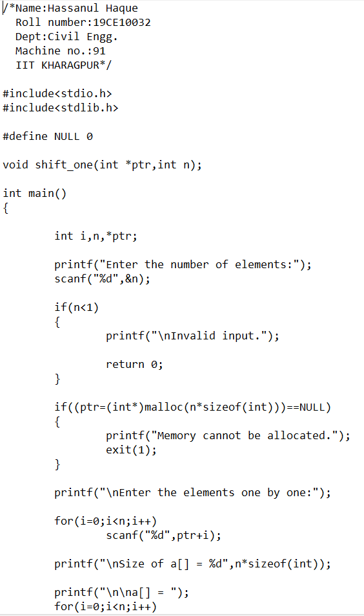
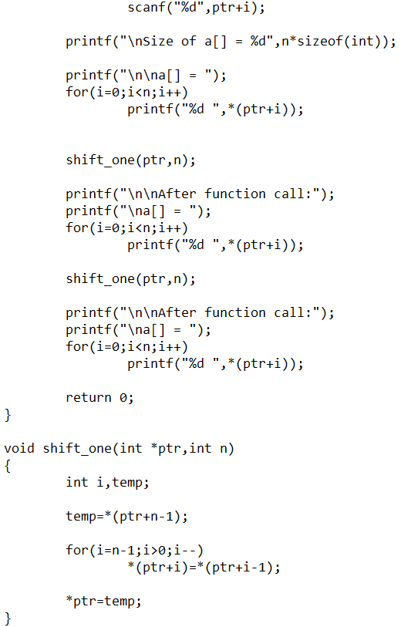
Implementation of modify_file_1 function on Test File
Original file

Slide 14
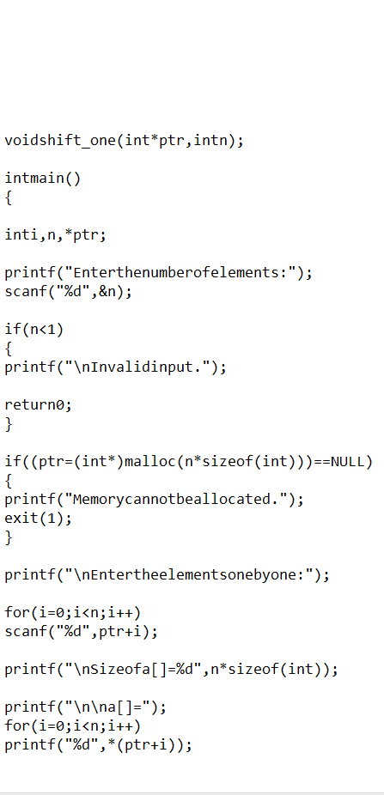
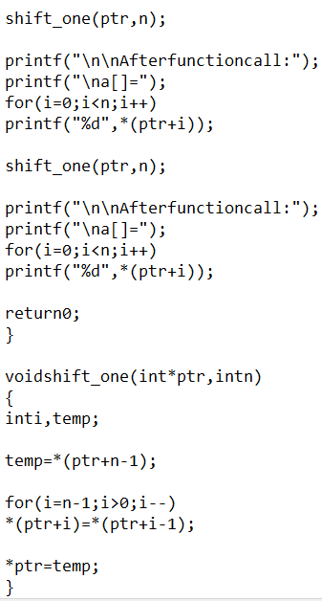
after implementing modify_file_1 function

Slide 15
modify_file_2 function
modify_file_2(file_name)
{
initialize count as 0
create a temporary file "temp.c"
open the file_name and temporary file in read and write mode respectively
while (extract lines of file_name one by one till it not end) // considering max length of the line as 1000
{
for (i = 0 to i < strlen(line) )
{
if line[i] = '\n', then continue the loop
print line[i] in temporary file
if line[i] = ';', then print '\n' in temporary file
}
}
close the file_name and temporary file
remove original file
rename modified file with the name of original file
}

Slide 16
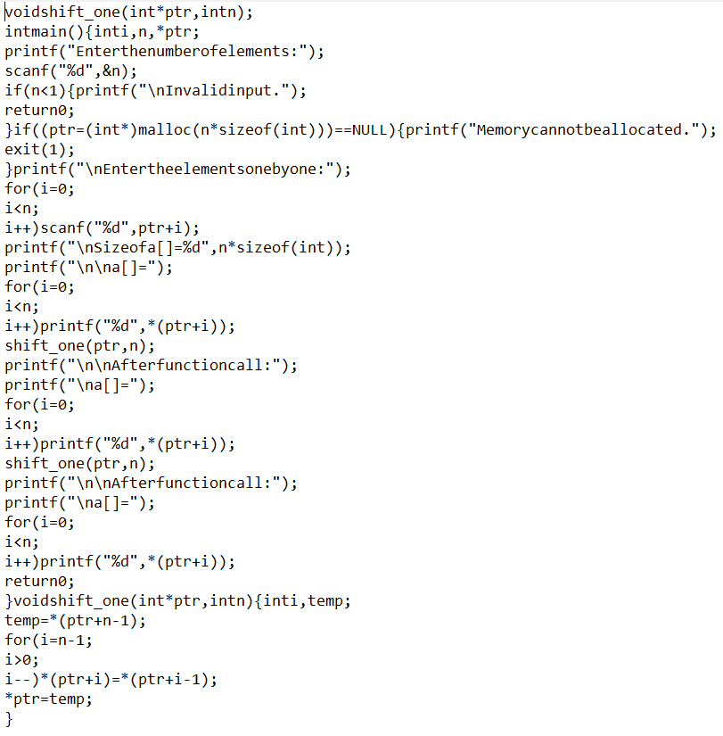
after implementing modify_file_2 function

Slide 17
calc_plagiarism(file_1, file_2)
{
initializing both number of plagiarised characters and total characters as 0
open both file_1 and file_2 in read mode
initialize flag as 0
while (extract lines of file_1 one by one till it not end) // considering max length of the line as 1000
{
while (extract lines of file_2 one by one till it not end) // considering max length of the line as 1000
{
i = 0;
flag=1;
while (if any of the lines has not ended with ';’) {
if (line_1[i] = line_2[i]), then plag_char++;
i++;
}
check if line_2 hasn't ended and if, then add the number of characters left in that line
check if line_1 hasn't ended and if, then add the number of characters left in that line
total_char += i;
break;
}
check if file_1 has more number of lines than file_2 and add the number of characters of those left lines
flag=0;
}

Slide 18
checking if file_2 has more number of lines than file_1 and add the number of characters of those left lines
plag_percent = (plag_char / total_char) * 100;
close the file_1 and file_2
return (plag_percent);
}
selectionSort(array_str, n)
{
for (i = 0 to i < n - 1) // one by one move boundary of unsorted subarray
{
min_idx = i; // find the minimum element in unsorted array
for (j = i + 1 to j < n)
if ((array_str[j].percentage_plagiarism) < (array_str[min_idx].percentage_plagiarism)),
min_idx = j;
swap the found minimum element with the first element
swap the x value of found minimum element with the x value of first element
swap the y value of found minimum element with the y value of first element
}
}
swap(xp, yp)
{
temp = *xp; *xp = *yp; *yp = temp;
}

Slide 19
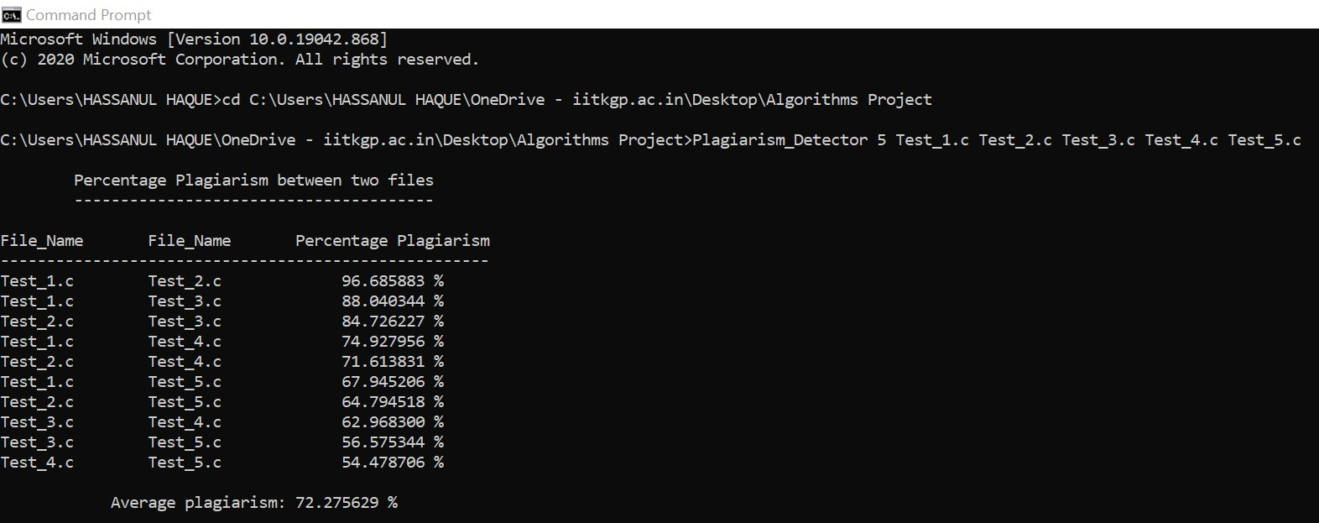
Input and Output Screen

Slide 20

Time Complexity of Algorithm

Slide 21
Space Complexity of Algorithm
For n no. of files, we will require an array of ^{n}C₂ size to store the results, which will be of O(n²).
To store name of files: O(n) , where n = number of files
To store temp file & modify it: O(size_of_file)
Therefore, total space complexity = O(n²) + O(n) + O(size_of_file) ☰ O(n²) + O(size_of_file)

Slide 22

Pseudo-Code of PART-2
main() {
file1 = take input file1;
file2 = take input file2;
para1 = divideInPara(file1);
para2 = divideInPara(file2);
n = no. of para in file 1
m = no. of para in file 2
for(i=0 to n-1){
for(j =0 to m-1){
max = 0;
k = matchpara(p1[i],p2[j]);
if(k > max)
max = k;
}
}

Slide 23
matchpara(p1,p2){
n=numsent(p1); //no. Of sentence in para-1.
m=numsent(p1);
sent1 = divide_in_sent(p1);
sent2 = divide_in_sent(p2);
for(i=0 to n-1){
max = 0;
for(j=0 to m-1){
k=matchsent(sent1[i],sent2[j]);
if(max<k)
max = k;
}
match[i] = max*100/num_of_word[i];
}
return (Σ match[i]/n);
}
matchsent(s1,s2){
w1 = divide_in_word(s1);
w2 = divide_in_word(s2);
return (LCS(w1,w2));
}
LCS(w1,w2){
//where w1[1..n],w2[1..m] store n and m //words resp.
for(i=1 to n)
L(i,0)=0;

Slide 24
for(j to m) L(0,j)=0;
for(i=1 to n){
for(j= 1 to m){
if(w1[i]=w2[j])
L[i,j] = L[i-1,j-1] + 1;
else
L[i,j] = max(L[i-1,j],L[i,j-1]);
}
}
return L[n,m];
}

Slide 25


Time & Space Complexity of Algorithm

Slide 26
Conclusion
Our Plagiarism Detector tool is a code-based system which uses techniques like normalization which includes removing comments, header-files, white-spaces, line-spaces etc from all the files that needs to be checked.
Then, we compare the files on the basis of their content.
We then rank the files according to the percentage-plagiarism found in the files(in decreasing order).

Slide 27
Future Work
As we have already discussed the algorithm for comparing text files, so now with the help of this, any programmer can implement this in C/C++ or any other programming language.
Now as improvement in our algorithm, one can also add features to our algorithm such that even for two programming files having the same functionality but just the variable names are changed, the plagiarism percentage should reflect that.
Another suggestion could be if by someway we can find the running time of the programming files, then it would make the algorithm more efficient.

Slide 28
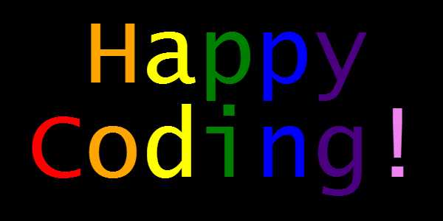

Thank you!

